Slide 1
File Integrity Monitoring System
A lightweight File Integrity Monitoring System that verifies the integrity of important business files, helping organizations quickly detect unauthorized or unexpected changes.

Slide 2
The Problem SMEs Face
Most small and medium businesses have no affordable way to monitor critical files for unauthorized changes. The result?
🔍 Undetected File Modifications
🗑️ Accidental Deletions
Important business files can be changed without anyone realizing that the content has been altered.
Files vanish without a trace
📂 Unnoticed New Files
📊 No Simple Integrity Verification
New files can appear in monitored folders without users realizing they have been added.
Most SMEs do not have an affordable way to regularly verify that their important files remain unchanged and trustworthy.

Slide 3
What It Is — Simply Put
The system creates a trusted fingerprint of every file in a monitored folder using SHA-256 hashing. On every rescan, it compares current fingerprints to the baseline and instantly flags any changes.
Modified Files
Deleted Files
New Files
Content was changed
Files that disappeared
Unknown files added

Slide 4

How It Works
Generate Baseline
Rescan & Compare
Select Folder
Detect & Alert
Generating a baseline means taking a trusted "snapshot" of all the files in a folder so the system knows what they originally looked like.

Slide 5
Key Features
Folder Selection & Monitoring
SHA-256 Baseline Creation
Alerts & Logs
Integrity reports are available after process is completed.
Choose any folder to watch — simple and flexible.
Cryptographically secure hash of every file at rest.

Slide 6



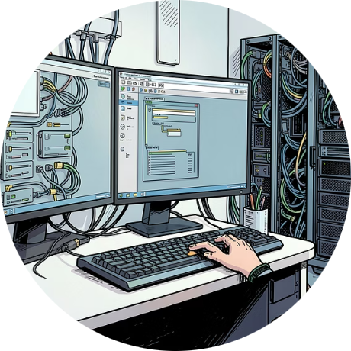
Who It's For
Error uploading image.
SMEs
Educational Institutions
Healthcare Facilities
IT Admins & Security Teams
Affordable protection without enterprise complexity
Monitor sensitive patient data for compliance
Guard student records and academic files
Practical, lightweight tool for daily operations

Slide 7
Why It Matters for Your Business
🔒 Protects File Integrity
⚠️ Early Detection
📁 Improves Document Control
Detects modified, deleted, and newly added files.
Identifies unexpected file changes before they impact operations.
Helps maintain accurate and trustworthy business records.

